Slide 1
Learning dynamics from single-cell time series
Single-cell Workshop January 2021
Notes:
Hi I’m Alex Tong, and today I’ll be talking about our project TrajectoryNet, which blends continuous normalizing flows and dynamic optimal transport to solve problems in modelling the transcriptome over time.

Slide 2
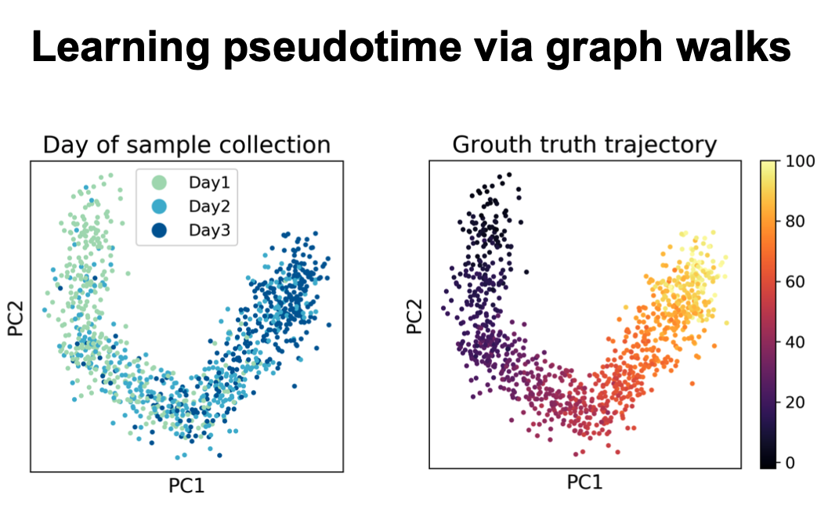

Slide 3
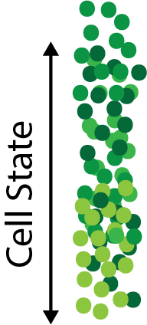

Motivation
Notes:
The problem we tackle in this paper is how to predict longitudinally from cross sectional data. Cross-sectional data in this context, is data given as samples from a population at a small number of discrete times. These are representative samples from the population at each time, but we do not know the correspondence of individual points between timepoints.
An example of this type of data might be survey or polling data. We do not poll the same individuals at each time but receive a sample from the population. Here we focus on cells, where current technologies require destroying the cells to measure them, preventing measuring the same cell at more than one timepoint. We are able to sample the population at some discrete timepoints, but individual cells do not correspond between timepoints, thus data must be processed at a distribution level.

Slide 4
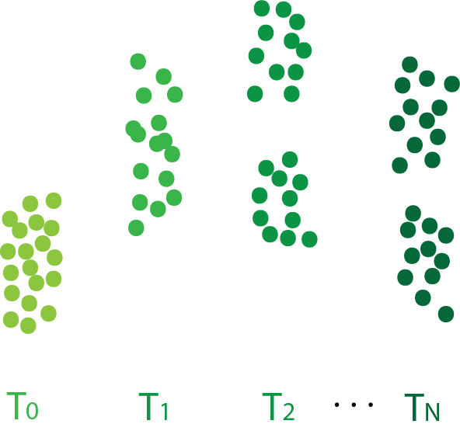
Motivation
Longitudinal inference from snapshots
Notes:
The problem we tackle in this paper is how to predict longitudinally from cross sectional data. Cross-sectional data in this context, is data given as samples from a population at a small number of discrete times. These are representative samples from the population at each time, but we do not know the correspondence of individual points between timepoints.
An example of this type of data might be survey or polling data. We do not poll the same individuals at each time but receive a sample from the population. Here we focus on cells, where current technologies require destroying the cells to measure them, preventing measuring the same cell at more than one timepoint. We are able to sample the population at some discrete timepoints, but individual cells do not correspond between timepoints, thus data must be processed at a distribution level.

Slide 5
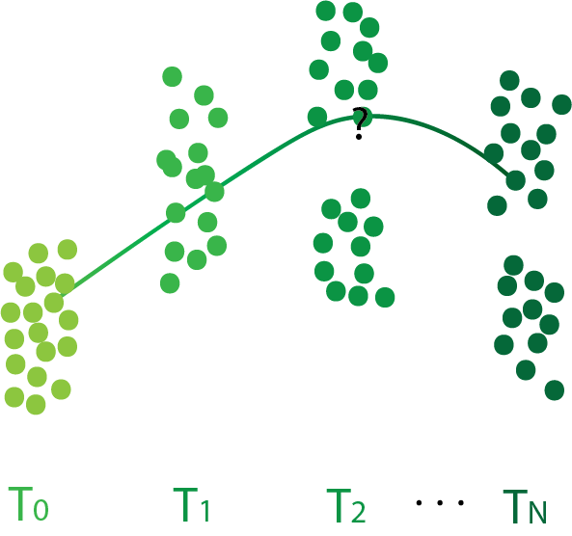
Motivation
Longitudinal inference from cross sectional measurements
Tasks:
Predict trajectory of a point
Notes:
One question we might want to ask is given an individual at a specified time, what is the likely trajectory, in other words at a new time, what is its state.

Slide 6
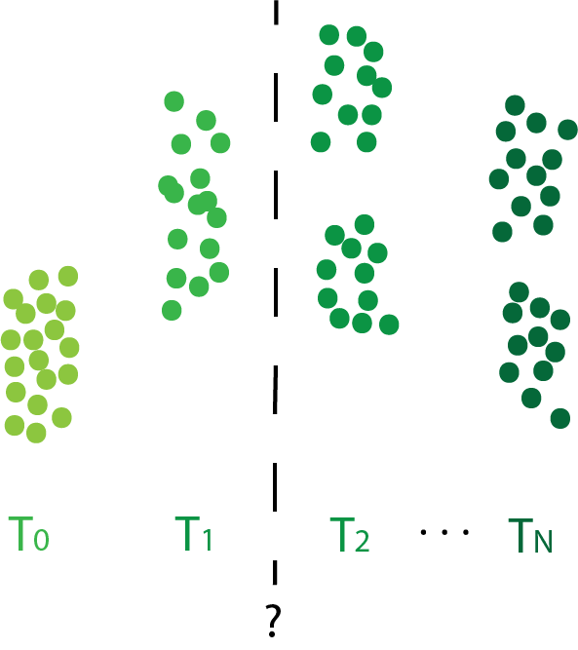
Motivation
Longitudinal inference from cross sectional measurements
Tasks:
Predict trajectory of a point
Predict distribution at test timepoint
Notes:
Another problem might be to infer the likely distribution over states at an unobserved time. We will show how to solve these two tasks efficiently with TrajectoryNet and apply this to the single transcriptomic data.

Slide 7
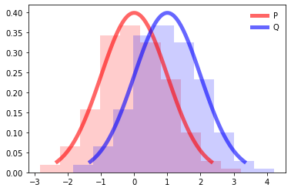
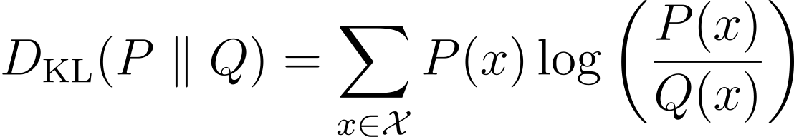
Divergences between probability distributions
Kullback-Liebler Divergence D_{KL}

Slide 8
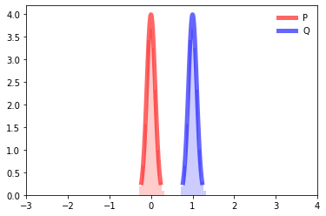
Divergences between probability distributions
Kullback-Liebler Divergence D_{KL}
Notes:
D_\text{KL}(P \parallel Q) = \sum_{x\in\mathcal{X}} P(x) \log\left(\frac{P(x)}{Q(x)}\right)
D_\text{KL}(P \parallel Q) = \infty

Slide 9
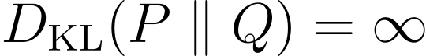
Divergences between probability distributions
Kullback-Liebler Divergence D_{KL}
Notes:
D_\text{KL}(P \parallel Q) = \sum_{x\in\mathcal{X}} P(x) \log\left(\frac{P(x)}{Q(x)}\right)
D_\text{KL}(P \parallel Q) = \infty

Slide 10
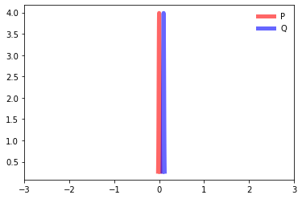
Divergences between probability distributions
Kullback-Liebler Divergence D_{KL}
Notes:
D_\text{KL}(P \parallel Q) = \sum_{x\in\mathcal{X}} P(x) \log\left(\frac{P(x)}{Q(x)}\right)
D_\text{KL}(P \parallel Q) = \infty

Slide 11
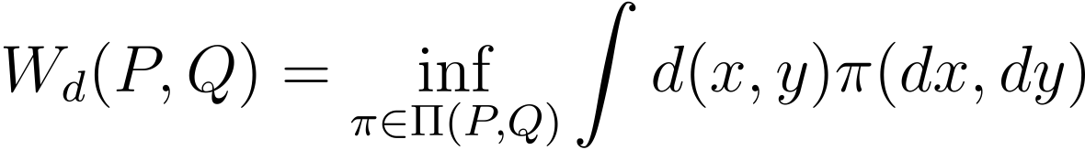
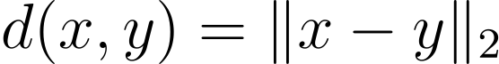
Optimal Transport – The Earth Mover’s Distance
Wasserstein Distance:
Ground “cost” or distance:
Notes:
D_\text{KL}(P \parallel Q) = \sum_{x\in\mathcal{X}} P(x) \log\left(\frac{P(x)}{Q(x)}\right)
D_\text{KL}(P \parallel Q) = \infty
W_d(P, Q) = \inf_{\pi \in \Pi(P, Q)} \int d(x, y) \pi(dx, dy)
d(x,y) = \|x- y\|_2

Slide 12
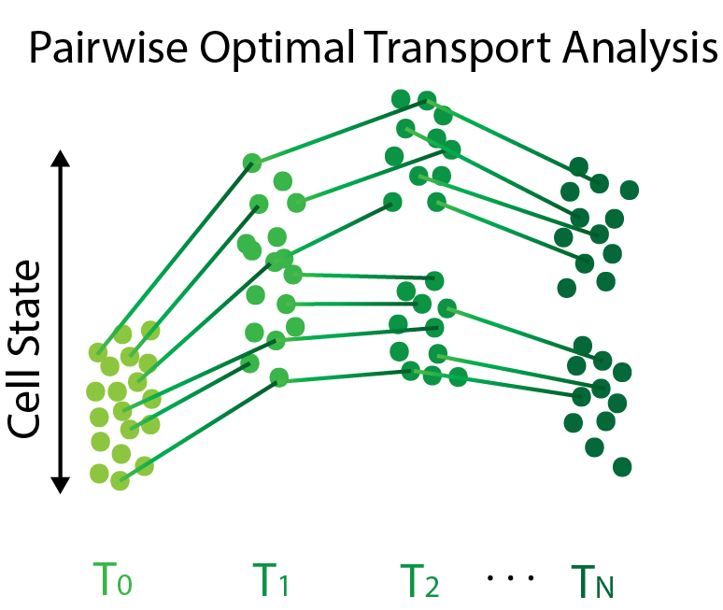
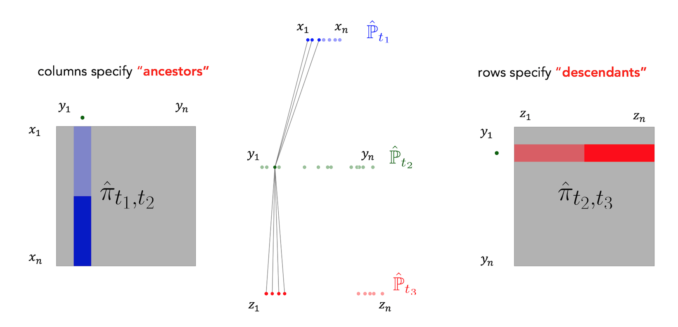
Optimal Transport – The Earth Mover’s Distance
For two distributions compute the “coupling” that minimizes the total cost.
Pushforward T:
P_{T2} = T#(P_{T1})

Slide 13
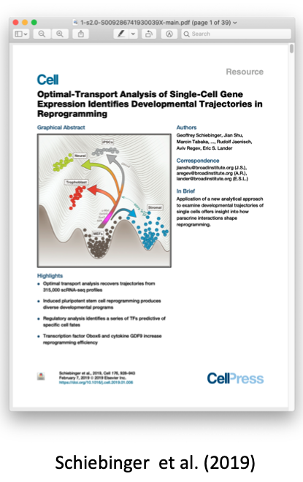
Waddington-OT
Specify cost as Euclidean distance between cells
Calculate coupling between timepoints
Use coupling to infer predict trajectories of a point or distributions at an intermediate time

Slide 14
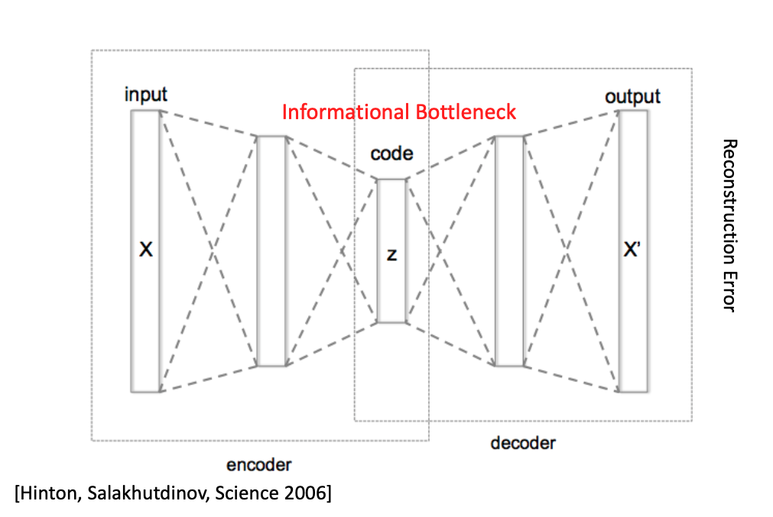
Autoencoders

Slide 15
Invertible Neural Networks
Invertible Layers

Slide 16
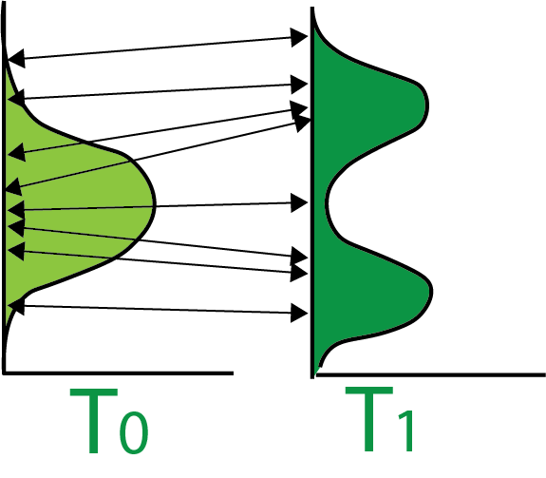
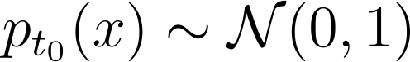
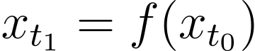
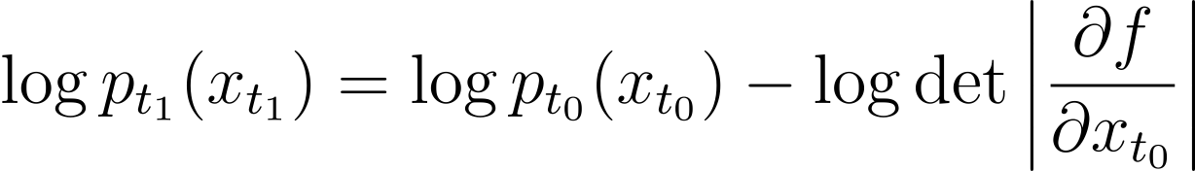
Normalizing Flows (NFs)
Begin with a simple distribution
Apply an invertible transformation(s)
Use change of variables to calculate probability
Notes:
First, before we get into continuous normalizing flows, a little bit about standard normalizing flows.
<next>
Normalizing flows transform a simple distribution often the standard Gaussian distribution, into a more useful one with an invertible neural network, or a series of invertible transformations.
<next>
The invertibility means that we can apply the change of variables formula to calculate the probability, or the log probability of any point at time t_1. This log probability then can be maximized according to the maximum likelihood principle.
<next>
Generally the challenge computationally is computing this log determinant,
<next>
Which turns out to be more efficient if we compose a series of simpler invertible transformations.
<next>
Composing a series of transformations is easy and is often thought of as composing layers in a neural network.
To calculate the log probability we now need to iterate backwards over the N transformations and sum up the log determinants.
-------------------
x_{t_1} = f(x_{t_0})
p_{t_0}(x) \sim \mathcal{N}(0,1)
\log p_{t_1}(x_{t_1}) = \log p_{t_0}(x_{t_0}) - \log \det \left | \frac{\partial f}{\partial x_{t_0}} \right |
\log p_{t_N}(x_{t_N}) = \log p_{t_0}(x_{t_0}) - \sum_{n=1}^N \log \det \left | \frac{\partial f_n}{\partial x_{t_{n-1}}} \right |

Slide 17
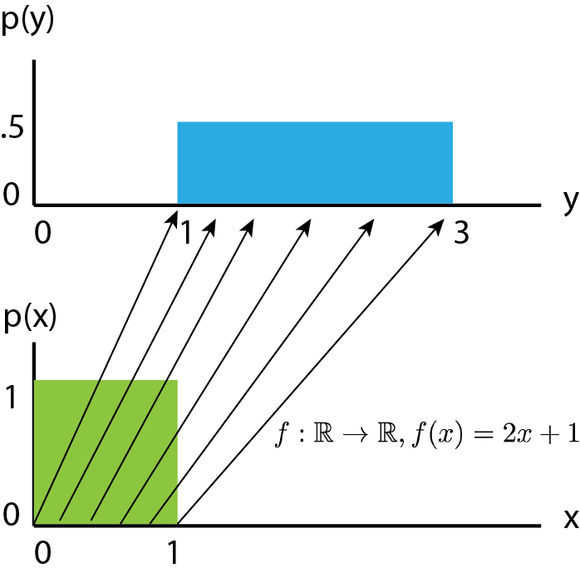
A note on change of variables
Visual borrowed from Eric Jang’s blog on Normalizing Flows

Slide 18
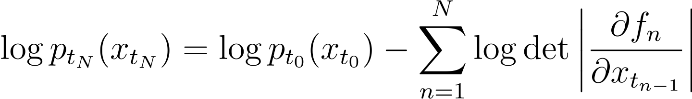
Deep Normalizing Flows (NFs)
Apply a series of transformations
Use change of variables to calculate probability
Notes:
First, before we get into continuous normalizing flows, a little bit about standard normalizing flows.
<next>
Normalizing flows transform a simple distribution often the standard Gaussian distribution, into a more useful one with an invertible neural network, or a series of invertible transformations.
<next>
The invertibility means that we can apply the change of variables formula to calculate the probability, or the log probability of any point at time t_1. This log probability then can be maximized according to the maximum likelihood principle.
<next>
Generally the challenge computationally is computing this log determinant,
<next>
Which turns out to be more efficient if we compose a series of simpler invertible transformations.
<next>
Composing a series of transformations is easy and is often thought of as composing layers in a neural network.
To calculate the log probability we now need to iterate backwards over the N transformations and sum up the log determinants.
------------
p_{t_0}(x) \sim \mathcal{N}(0,1)
x_{t_1} = f(x_{t_0})
x_{t_N} = f_N \circ f_{N-1} \circ \cdots \circ f_1(x_{t_0})
\log p_{t_1}(x_{t_1}) = \log p_{t_0}(x_{t_0}) - \log \det \left | \frac{\partial f}{\partial x_{t_0}} \right |
\log p_{t_N}(x_{t_N}) = \log p_{t_0}(x_{t_0}) - \sum_{n=1}^N \log \det \left | \frac{\partial f_n}{\partial x_{t_{n-1}}} \right |

Slide 19
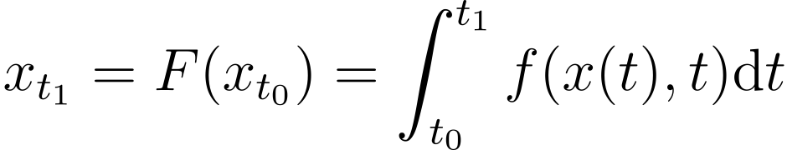
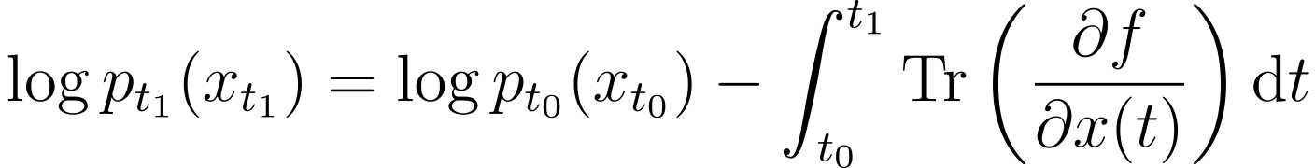
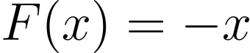
Continuous Normalizing Flows
Cannot model:
[Chen et al. 2018]
Notes:
As presented in Chen et al.’s paper Neural ODE, continuous normalizing flows take the number of layers to the limit, directly modeling the derivative of the flow, and integrating this derivative using standard numerical methods for solving ordinary differential equations to solve for X at time t_1. There are two useful side effects of taking the number of layers to the limit, the first is that the log determinant computation simplifies to a trace over the Jacobian, simplifying things computationally, although the integration time still dominates. The other useful side effect other is that flows cannot “cross” in an ODE. This means that they cannot model some relatively simple invertible functions like F(x) = -x. This is a problem for some applications, but we will show how it is useful in modeling cells.
---------------------
x_{t_1} = F(x_{t_0}) = \int_{t_0}^{t_1} f(x(t),t) \textup{d}t
\log p_{t_1}(x_{t_1}) = \log p_{t_0}(x_{t_0}) - \int_{t_0}^{t_1} \textup{Tr}\left ( \frac{\partial f}{\partial x(t)} \right ) \textup{d}t
As presented in Chen et al.’s paper Neural ODE, continuous normalizing flows take the number of layers to the limit, directly modeling the derivative of the flow, and integrating this derivative using standard numerical methods for solving ordinary differential equations to solve for X at time t_1. There are two other useful side effects of taking this limit, the first is that the log determinant computation simplifies to a trace over the jacobian, simplifying things computationally, the other is that flows cannot “cross” in an ODE. This means that they cannot model some relatively simple invertible functions like F(x) = -x. This is a problem for some applications, but we will show how it is useful in modeling cells.

Slide 20
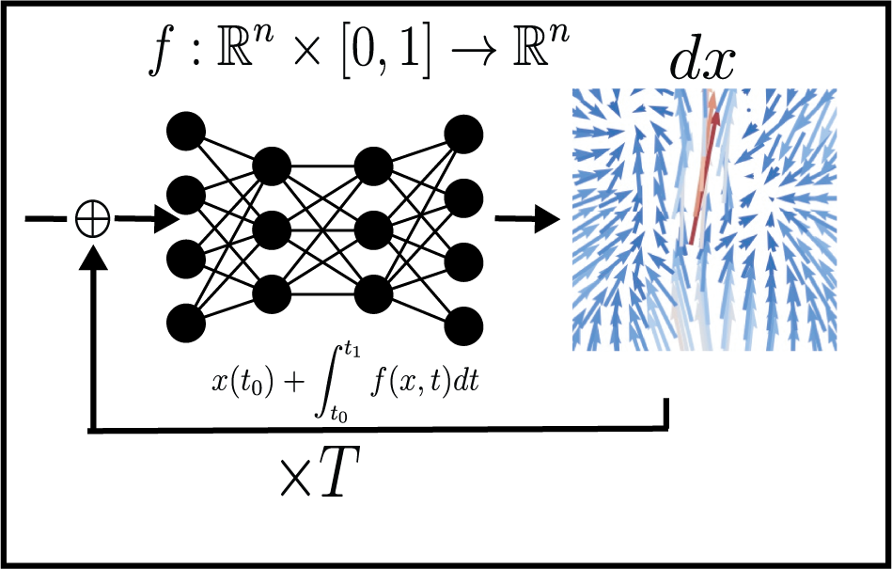
What does this look like?

Slide 21
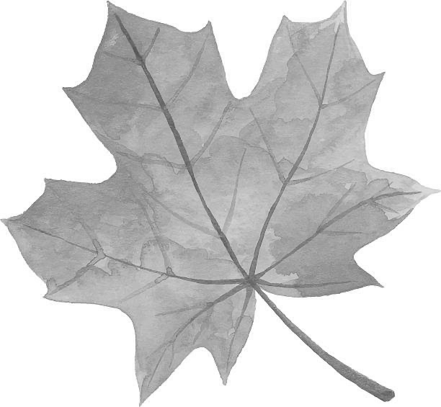
What does this look like?

Slide 22
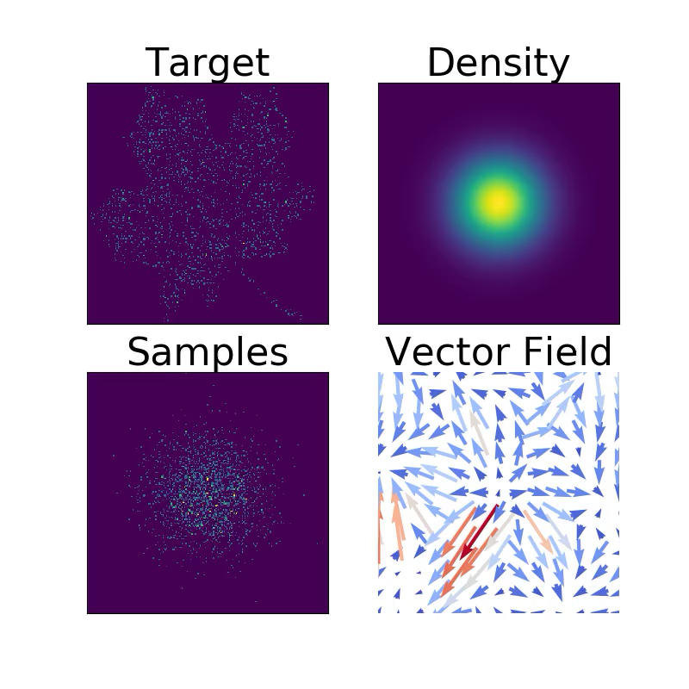
What does this look like?

Slide 23
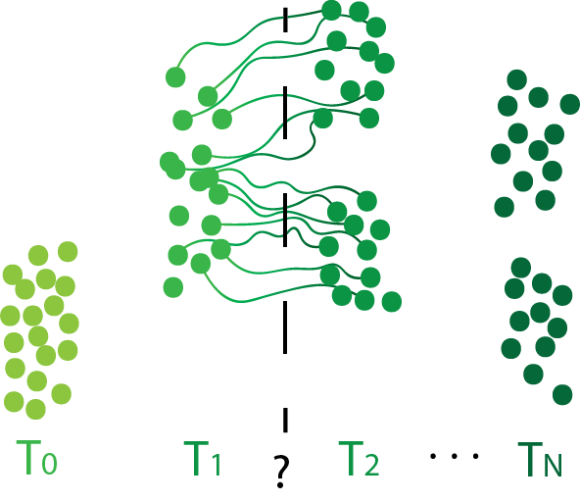
CNFs create continuous paths
Creates continuous paths, but they may not be biologically plausible — no restriction on circuitous paths!
[Chen et al. 2018]
Notes:
Continuous normalizing flows can be used to transport populations along time but may produce implausible or circuitous paths.
----------------
Literature on normalizing flows and continuous normalizing flows has focused on the generated output. In this project we are interested in the paths taken between distributions. With continuous normalizing flows we can conceptualize this as the smooth paths taken over time.
We can think of CNFs as optimizing for a set of paths where the start of the paths is a fixed simple distribution, and the ends of the paths are optimized to match some target distribution. This only constrains the distributions of the ends of the paths. Leaving the mapping between nodes and the middle of the paths unconstrained.

Slide 24
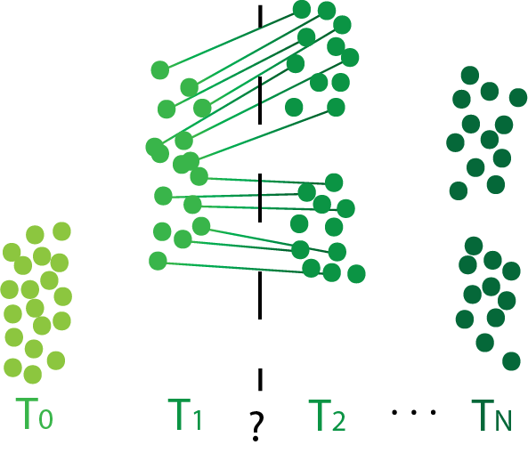
Obtaining straight paths via regularization
Penalize path energy: the squared L2-norm of the derivatives
Notes:
We next show how to adapt CNFs to our use through regularization of the paths. Penalizing the squared L_2 norm of the derivatives, can be thought of as penalizing path length, this tends to straighten paths and has a nice interpretation in terms of optimal transport.

Slide 25
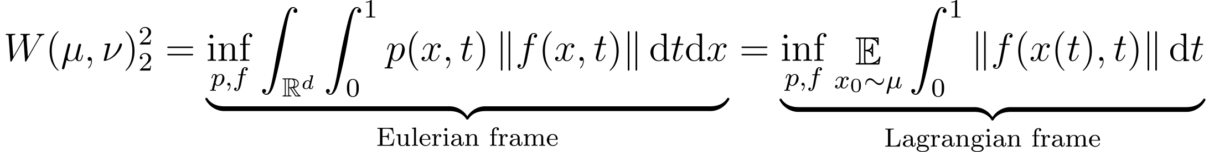
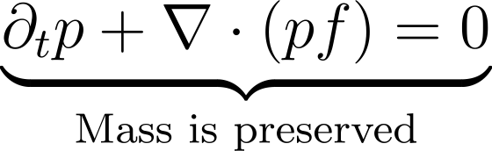
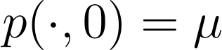
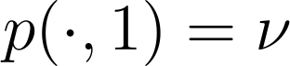
Regularized CNF approximates dynamic optimal transport
Dynamic OT:
𝜇
𝜈
Subject to:
Benamou and Brenier 2000
Notes:
Optimal transport studies how to move mass with minimal cost. For example, we have some pile of dirt represented by distribution mu at time 0 and want this dirt to be piled according to distribution \nu at time 1. This is traditionally solved as a linear program to determine the mapping between points at time 0 to time 1. However, this can also be interpreted in terms of dynamic optimal transport, which models the full path of particles over over time. Dynamic OT shows that optimizing a flow function f where the particles move the minimum expected distance and match the distributions at the beginning and end timepoints, then the expected distance a particle moves is equivalent to the Wasserstein distance.
<next>
Connecting this to normalizing flows with a squared L_2 penalty over f, the only difference is that the probability at time 1 is not fixed to \nu, but instead we optimize for the maximum likelihood at time 1, which is equivalent to optimizing the KL divergence between our flow at time 1, and the distribution \nu. As the KL-divergence term gets small then these flows are equivalent. For a more precise treatment see the paper.
-------------
W(\mu, \nu)^2_2 = \underset{\text{Eulerian frame}}{\underbrace{\inf_{p,f} \int_{\mathbb{R}^d} \int_0^1 p(x,t) \left \| f(x,t) \right \| \textup{d}t \textup{d}x}} = \underset{\text{Lagrangian frame}}{\underbrace{\inf_{p,f} \mathop{\mathbb{E}}_{x_0 \sim \mu} \int_0^1\left \| f(x(t),t) \right \| \textup{d}t}}
Here we use the squared L_2 distance as the cost of moving dirt from one location to another.

Slide 26
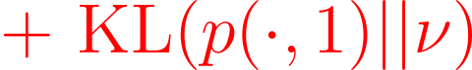
Regularized CNF approximates dynamic optimal transport
Dynamic OT: regularized CNF
𝜇
𝜈
Subject to:
Notes:
Optimal transport studies how to move mass with minimal cost. For an example we have some pile of dirt represented by distribution mu at time 0 and want this dirt to be piled according to distribution \nu at time 1. Here we use the squared L_2 distance as the cost of moving dirt from one location to another. This is the also known as the 2-Wasserstein distance. This is traditionally taken as a linear program to determine the mapping between points at time 0 to time 1. However, this can also be interpreted in terms of dynamic optimal transport, which models the full path of particles over over time. Dynamic OT shows that optimizing a flow function f where the particles move the minimum expected distance and match the distributions at the beginning and end timepoints, the the expected distance a particle moves is equivalent to the Wasserstein distance.
<next>
Connecting this to normalizing flows with a squared L_2 penalty over f, the only difference is that the probability at time 1 is not fixed to \nu, but instead we optimize for the maximum likelihood at time 1, which is equivalent to optimizing the KL divergence between our flow at time 1, and the distribution \nu. As the KL-divergence term gets small then these flows are equivalent. For a more precise treatment see the paper.
W(\mu, \nu)^2_2 = \underset{\text{Eulerian frame}}{\underbrace{\inf_{p,f} \int_{\mathbb{R}^d} \int_0^1 p(x,t) \left \| f(x,t) \right \| \textup{d}t \textup{d}x}} = \underset{\text{Lagrangian frame}}{\underbrace{\inf_{p,f} \mathop{\mathbb{E}}_{x_0 \sim \mu} \int_0^1\left \| f(x(t),t) \right \| \textup{d}t}}
\underset{\text{Mass is preserved}}{\underbrace{\partial_t p + \nabla \cdot (pf) = 0}}
p(\cdot, 0) = \mu
p(\cdot, 1) = \nu
{\color{Red} \textup{KL}(p(\cdot, 1), \nu)}

Slide 27
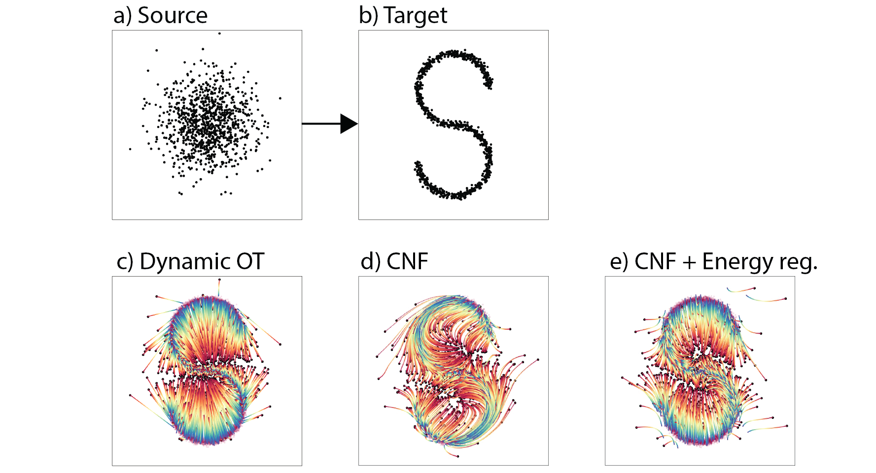
CNFs model Dynamic Optimal Transport
Notes:
For example, let’s examine the CNF that maps a 2d Gaussian to this distribution over the letter “S”. We show the paths over time of particles from red to blue, using different optimization strategies. Without regularization the CNF takes reasonable paths that are dictated by the implicit biases of the network architecture and optimization. Add this squared L_2 penalty to the flow function also known as the energy penalty, and we recover paths that are close to the optimal transport solution.

Slide 28
Inferring Continuous Flow in Static Snapshots
Notes:
At each timepoint the data is a static snapshot of gene profiles, i.e. a set of cells each with a vector of counts over ~20-30 thousand genes.

Slide 29
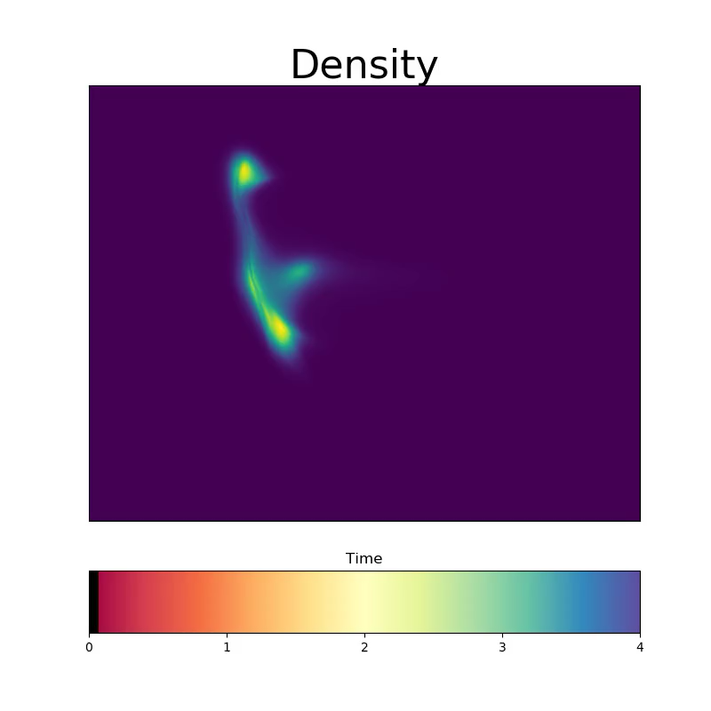
Inferring Continuous Flow in Static Snapshots

Slide 30
Additional properties of cells
Cells are not simply transported from one timepoint to another, they cells divide and die.
Cells cannot travel in straight paths through Euclidean space in terms of measured dimensions, cells only travel along a cellular manifold.
Though cells are destroyed when measured, we can estimate their direction of transition-based RNA velocity
Notes:
There are some additional properties of cells:
First, cells move, but they also grow and die, which we can model as an unbalanced transport problem.
Second, cells travel along a dense cellular manifold that is not linear in the ambient space.
And third, recent work based on RNA-splicing shows how to measure the approximate change in transcriptome for measured cells. This is termed “RNA-velocity,” and gives an estimate of the direction of each cell at the measured time.
These additional priors can improve our model of the transcriptome and can be efficiently encoded through the loss function of the continuous normalizing flow.

Slide 31
Cell Death and Growth
Allowing unbalanced transport can let cells “die” instead of moving them to implausible locations
Unbalanced transport hard to achieve dynamically
We use discrete optimal transport to assign growth and death rates
Liero et al. 2018
Notes:
To model cell growth and death we use unbalanced transport, which allows for the creation and destruction of mass at some cost. It is difficult learn the growth and death along with a flow, so we learn a separate model instead.
We use discrete optimal transport to estimate growth and death rates and learn a continuous model that is regularized by these values.
-----------------------------
Here we model growth through a separate network G trained from discrete unbalanced transport. We model the growth over time with this network. Red indicates relative growth at that time and position and blue indicates death. These growth values are added to the mass calculation, if the growth network outputs 2, this means a doubling of mass at that point. An output of 0.5 indicates a halving, and 1 indicates no change.

Slide 32
Cellular Manifolds
Implausible path
Cells have to transition through allowable parts of the state space
Enforce this with a density penalty. Based on a knn density estimate
Notes:
Cellular state space is lower dimensional than the ambient measurement space, cells grow and differentiate in a restricted smooth manifold. We constrain the flow as much as possible to areas where there is density. To avoid implausible paths through no density.
<next>
This loss is a hinge penalty on the k nearest neighbors, for some randomly interpolated timepoint t, if your k nearest neighbors are beyond some radius h, then we encourage the path to be closer to those neighbors.
This trades off energy efficiency for our prior that cells follow a low dimensional manifold.

Slide 33
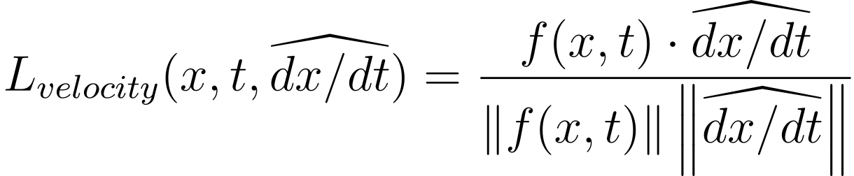
Velocity Regularization
RNA Velocity, estimate of direction of change
[La Manno et al. 2018 Velocyto; Volker et al. ScVelo]
Notes:
RNA velocity gives a local estimate of cellular change, depicted here on this plot, it is also empirically extremely noise. We find it gives a good estimate of direction, but not of overall magnitude. Thus we penalize the cosine distance between our predicted direction of change f, and the RNA velocity at all datapoints.
This matches direction but ignores magnitude.

Slide 34
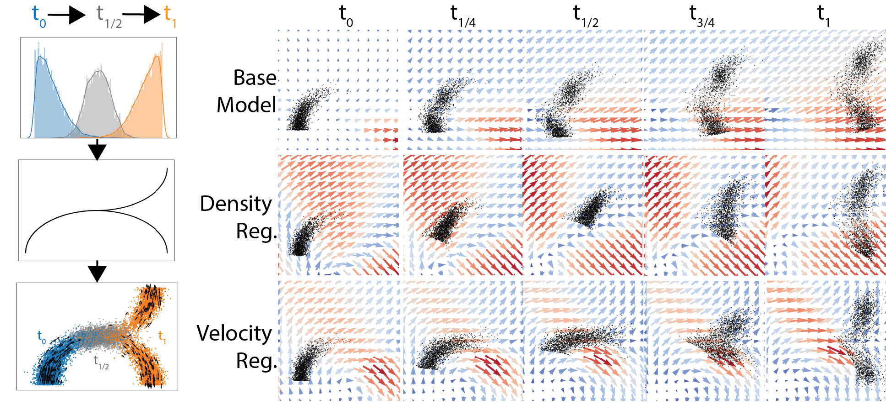
Toy Example
Notes:
To give an example of what this looks like, we show a simplified example. Here we embed some 1d distributions on a 1d manifold in 2 dimensions. The gray distribution is computed with optimal transport in 1D, i.e. along the manifold. We train the model to map the distribution at time 0 to the distribution at time 1. With the idea that at time ½ we should match the gray distribution. These arrows model the flow, and the points show the distribution. The base model shows how without these additional penalties we move in straight lines, splitting density immediately. With density or velocity penalties we follow the 1d manifold and approximately match the gray distribution at time ½.

Slide 35
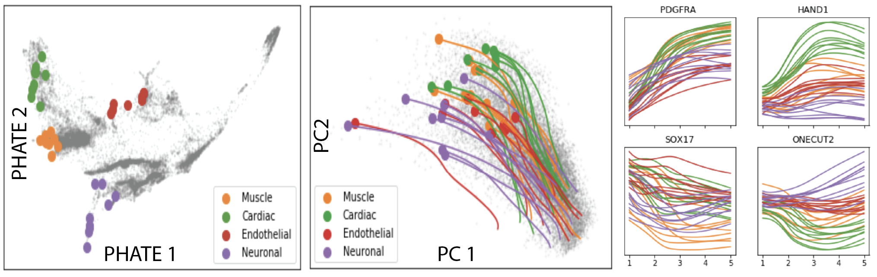
Tracing Ancestry
Notes:
Once we have a TrajectoryNet model, we can trace back the ancestry of easily identified and well differentiated cells to search for early markers of their divergence. This is important for understand gene regulation and can potentially discover novel markers of development or disease.

Slide 36
Summary
Energy regularized CNF performs dynamic optimal transport to find flows between cross-sectional populations
TrajectoryNet includes additional regularizations that allow for optimal transport on a manifold, with growth and death of individuals over time, and respecting individual velocity data
Trajectories of individual cells, and gene expression activity can be inferred
Notes:
In summary,
Through energy regularization, continuous normalizing flows can be modified to perform dynamic optimal transport.
TrajectoryNet takes this regularized CNF and adds other penalties to give plausible cellular trajectories according to our assumptions.
We can then interpolate individual trajectories or populations to understand the transcript space.

